Slide 1
Bray Team Week 10 Update
Avery Haynes, Locke Lehmann, Travis Carlson, Cody Sims, Zachary Walker, Michael Hager
4/1/2024

Slide 2
Weekly Deliverables
Tasks | Lead | Percentage Done | Notes
Begin potentiometer validation testing | Avery/Michael | 50% | Ready for testing.
Strain Gauge Measurement | Avery/ Michael | 50% | Purchased some components.
Test motor system | Cody/Travis | 50% | Motor mounted into the stem of the actuator and wired to DAQ
Implement strain gauges into stop bolts | Zack | 100% | Completed
Prep Hall effect sensor Test | Locke/Travis | 50% | Printed test rig.

Slide 3
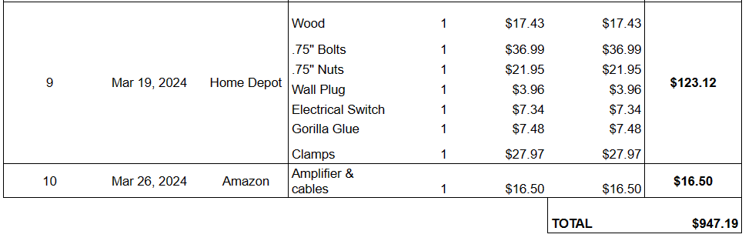
Purchasing Updates
Purchased strain gauge amplifier from Amazon
Budget Update: $947.19 spent (out of $3,803 approved)
Notes:
Done - Avery 2/18

Slide 4
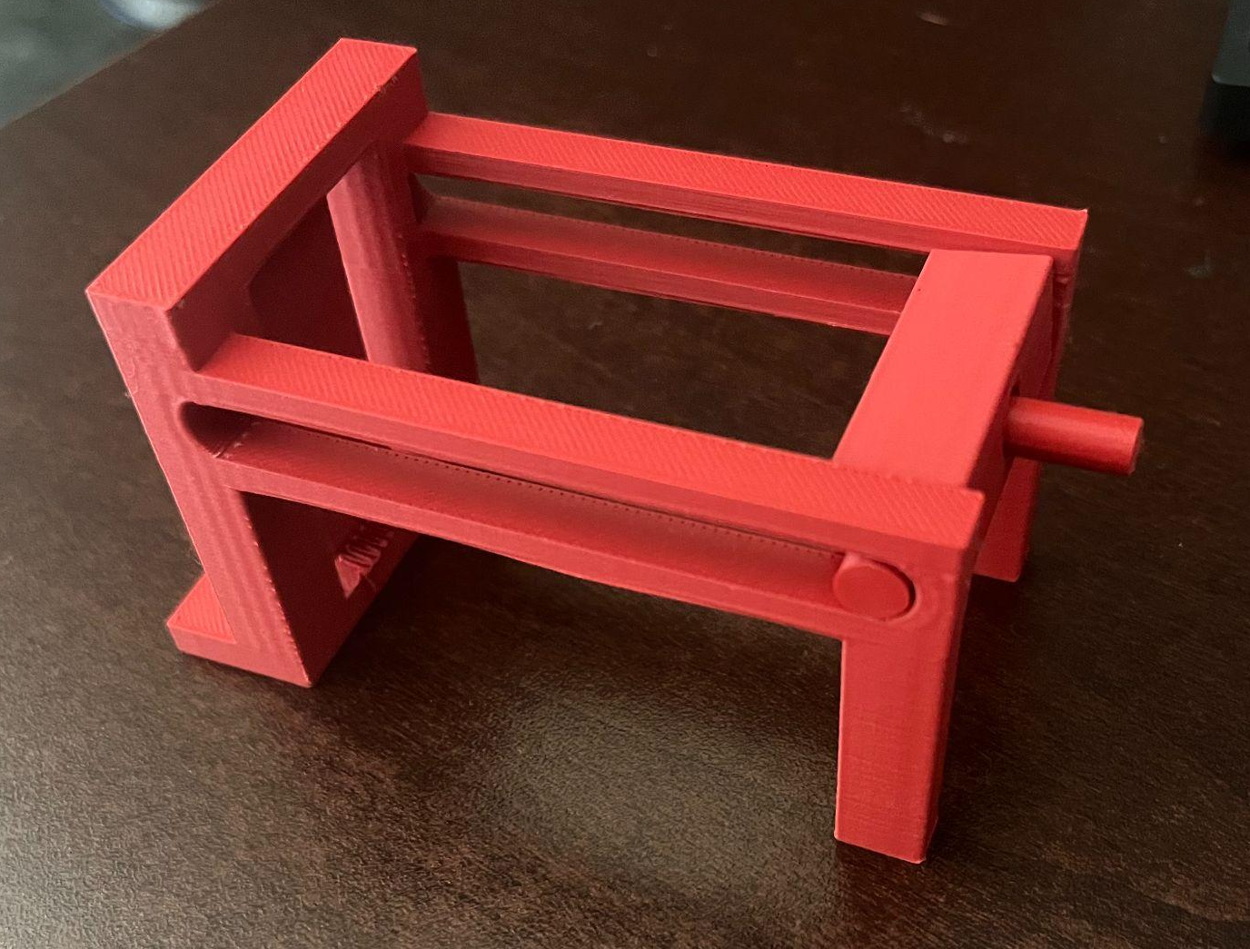
Hall effect sensor testing apparatus
Frame finished printing late Thursday
Picked up today and will begin testing the Hall effect sensor this week

Slide 5
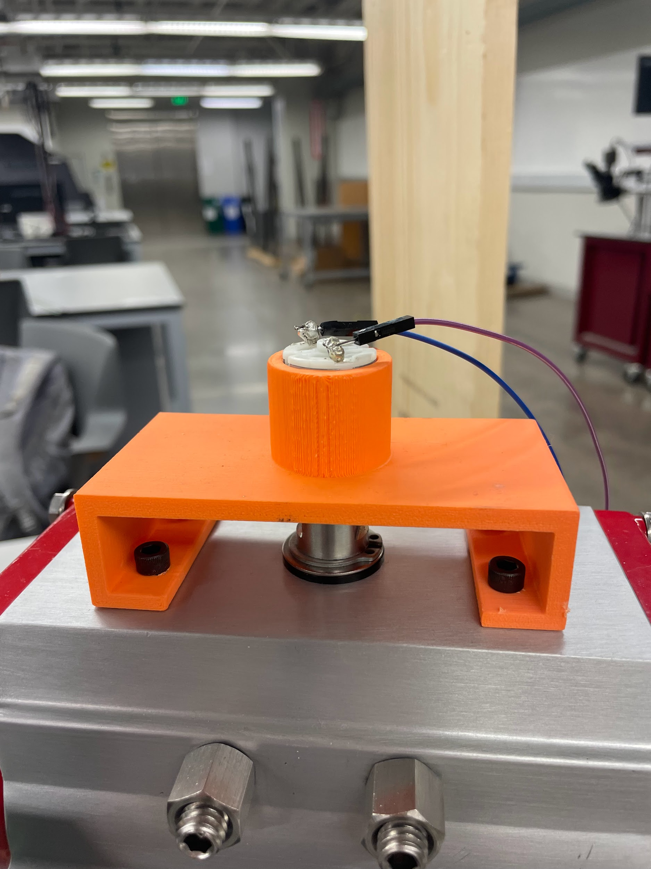
Electric Motor
Soldered wires to electric motor for DAQ
Motors can be switched in and out - and we have backups of every sensor type

Slide 6
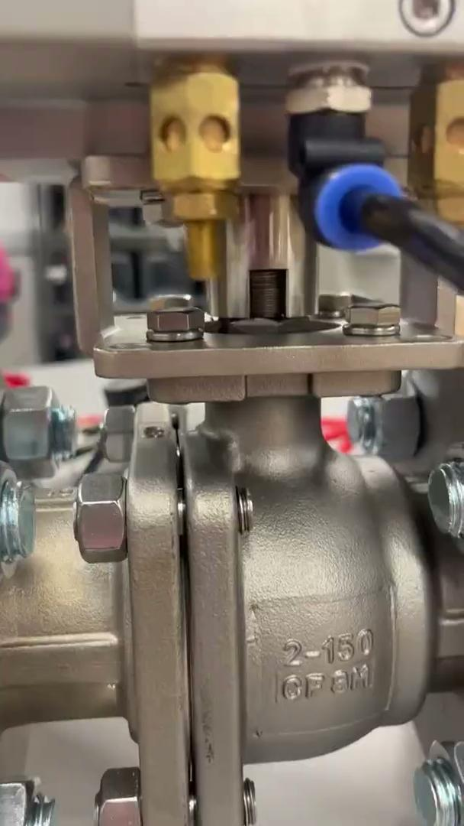
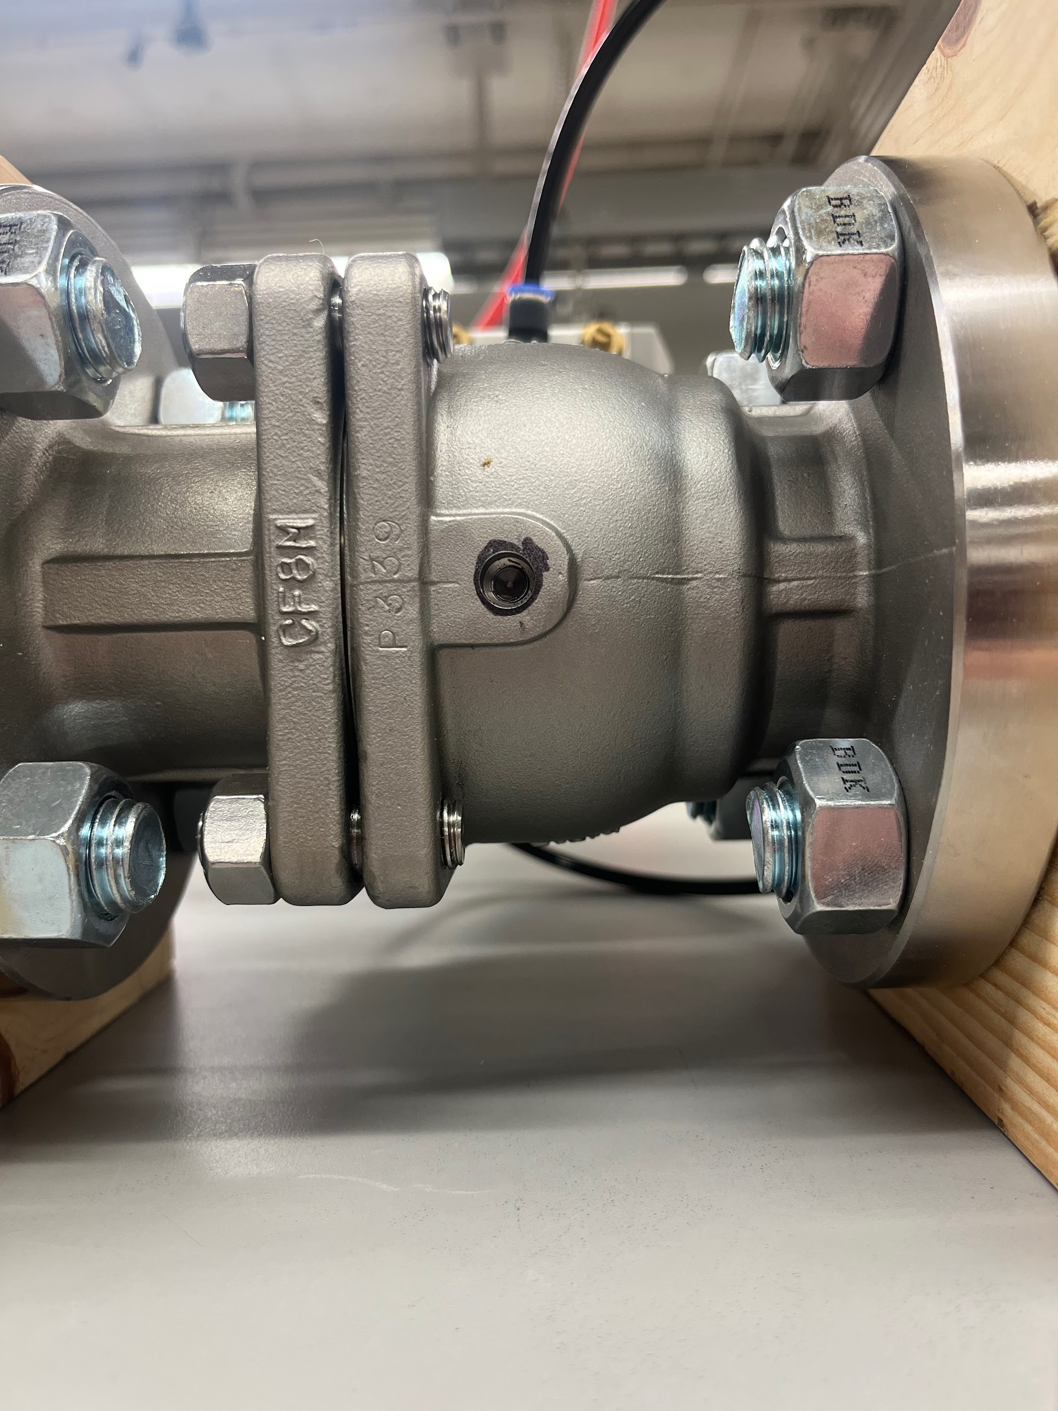
Firing the Actuator
It works! Just had to tighten connections
Shop air was off Thursday - should be on this week for testing (for real this time)
Hole still aligns after many turns:

Slide 7
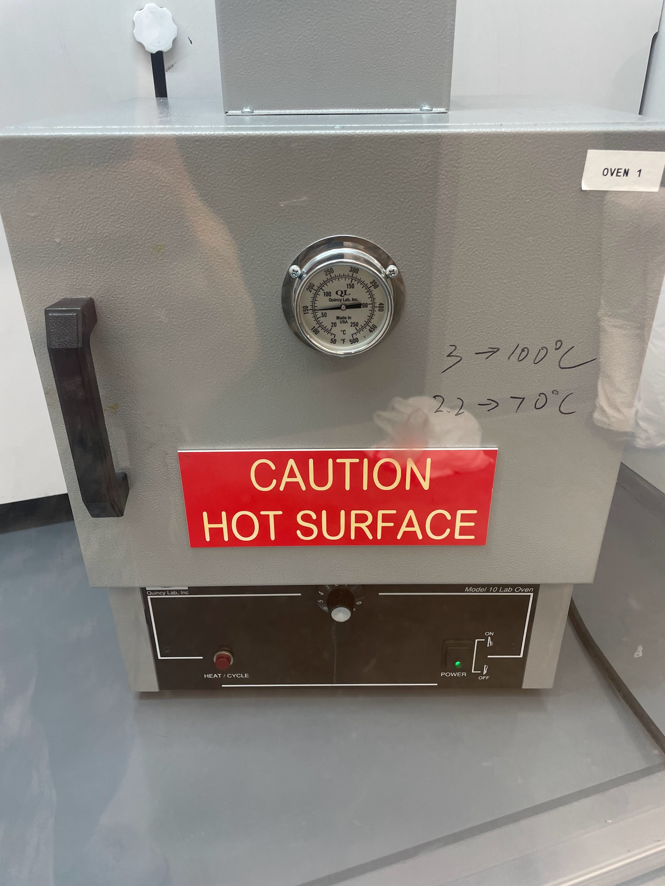
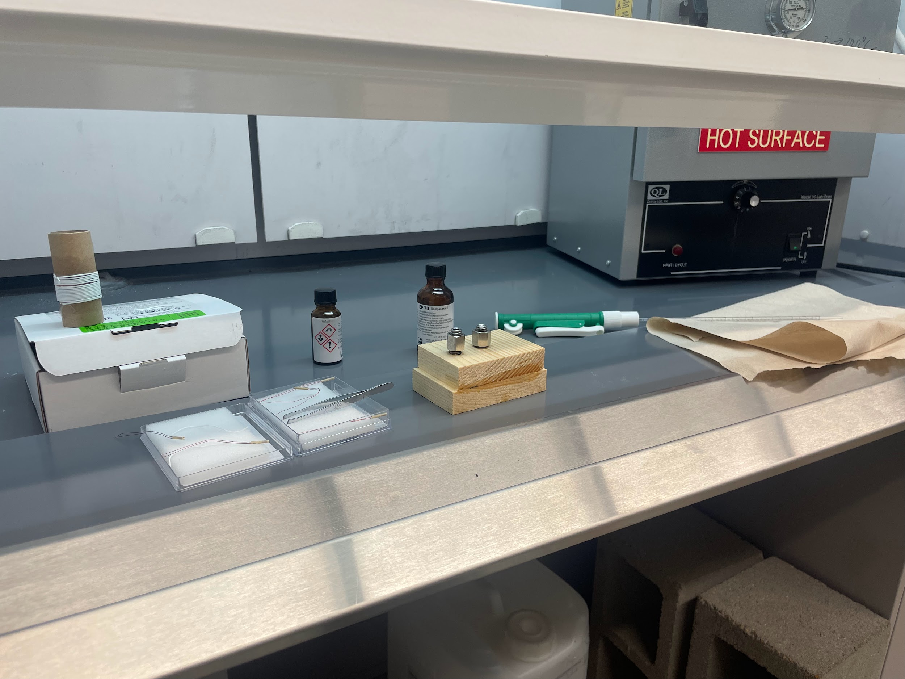
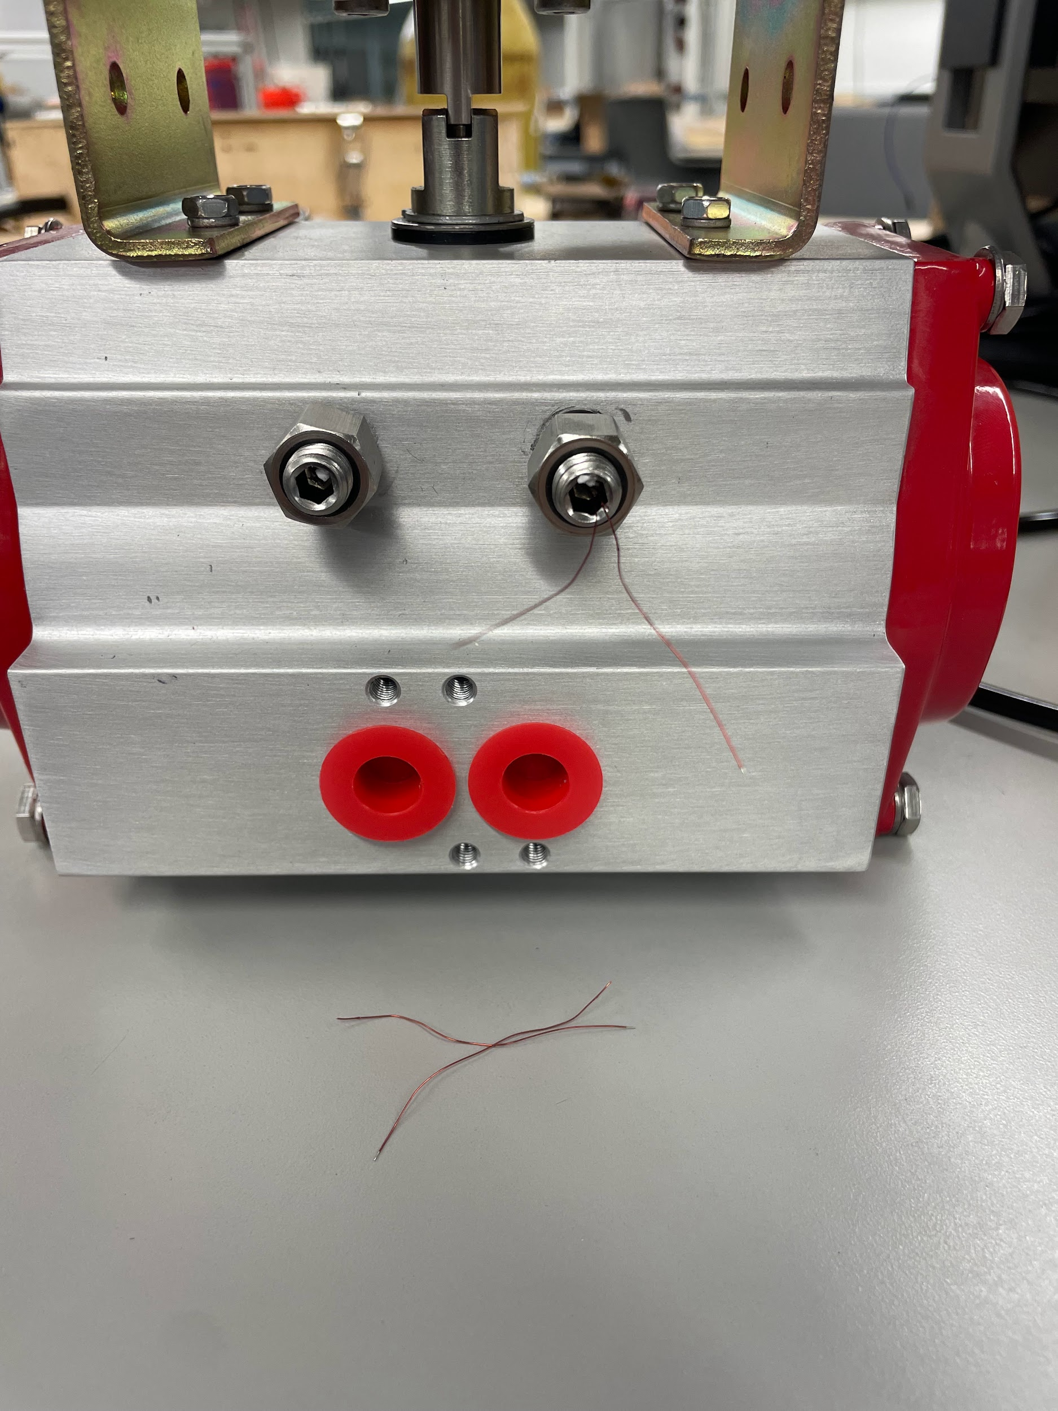
Major Success, Minor Mistake
Epoxy successful but accidentally pinched the wires and they broke on one gauge - if absolutely necessary, we do have extras
Will be very careful and had no further issues with the other, so maybe just a bad job of epoxying on the one

Slide 8
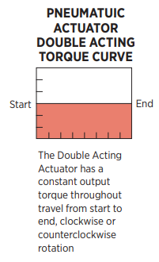
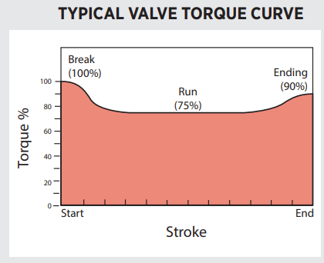
Why It’s Not A Big Deal
Double acting actuator - theoretical flat torque curve
Each bolt will alternately experience start and end torque - can measure both from one bolt and sort readings with code

Slide 9
Remaining Validation
Test potentiometer and electric motor
Complete strain gauge DAQ setup and test
Test Hall Effect sensor on rig and find best way to implement into valve

Slide 10
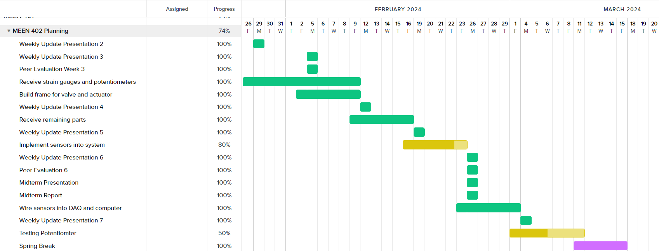
Gantt Chart

Slide 11
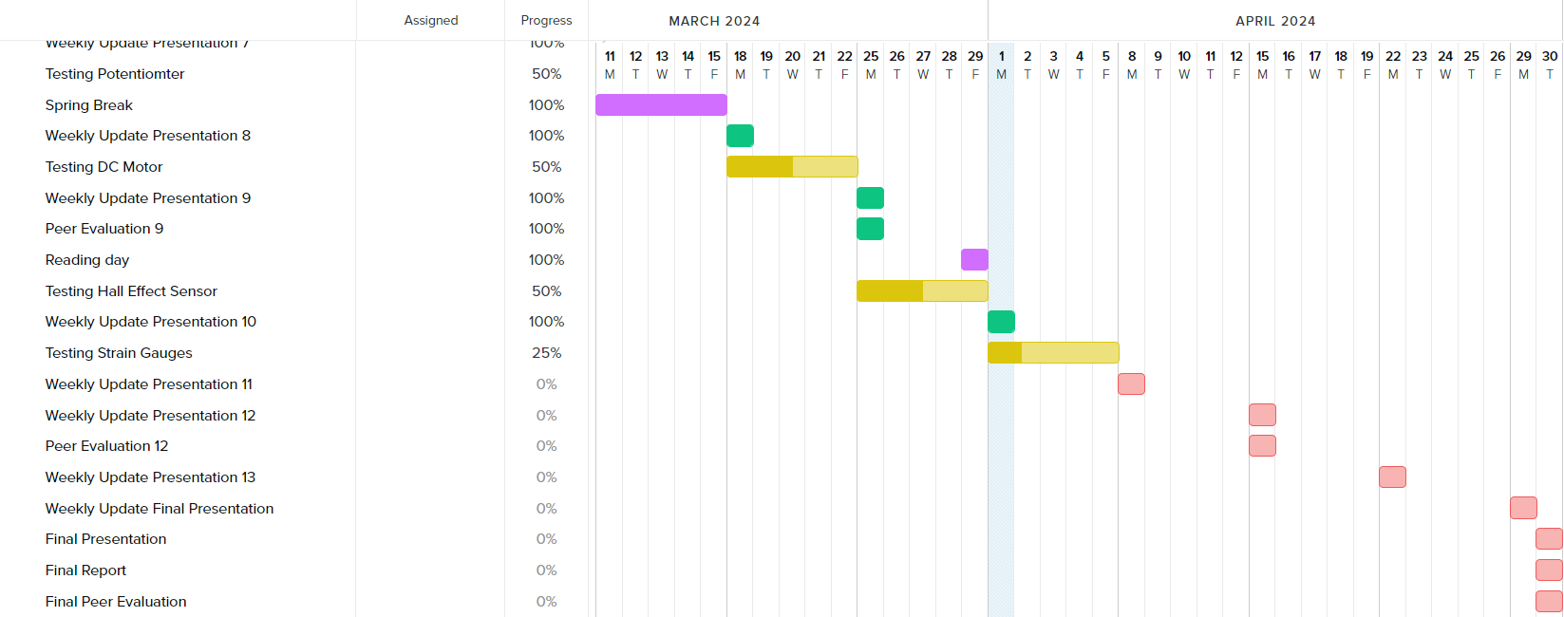
Gantt Chart

Slide 12
Next Week’s Deliverables
Tasks | Lead | Percentage Done | Notes
Begin potentiometer validation testing | Avery/Michael | 50% | Ready for testing.
Strain Gauge Measurement | Avery/ Michael | 50% | Purchased some components.
Test motor system | Cody/Travis | 50% | Motor mounted into the stem of the actuator and wired to DAQ
Hall effect sensor test | Locke/Travis | 50% | Printed test rig.

